Slide 1

MINI PROJECT USING C LANGUAGE
Vehicle Parking Management System

Slide 2
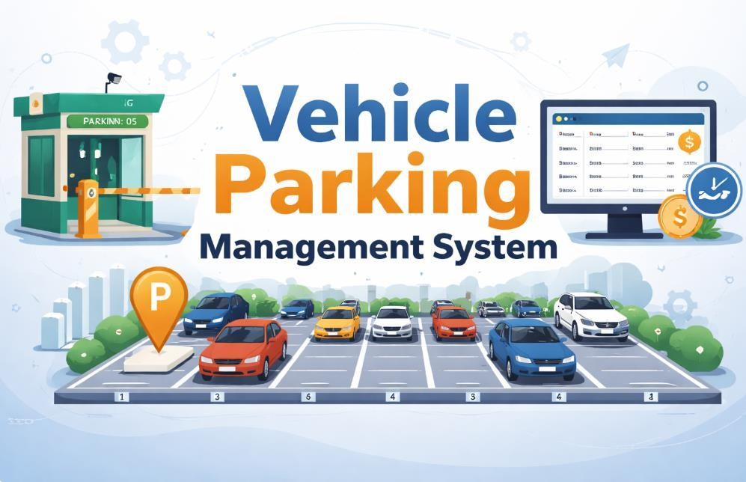

Slide 3
Introduction
Parking management is an important aspect in modern cities where large numbers of vehicles
require organized parking spaces. Manual parking management often leads to errors in vehicle racking and billing.
The Vehicle Parking Management System is designed to simplify the process of storing vehicle
information and calculating parking charges. Using C programming, the system stores data in files and retrieves it when required.
This project helps students understand practical implementation of programming concepts such as structures, file handling, and menu-driven programs.

Slide 4
Objectives
To design a simple vehicle parking management system using C
programming.
To store vehicle information using file handling
techniques.
To manage different types of vehicles such as Bike,
Car, and Truck.
To calculate parking charges automatically based on
vehicle type and hours.
To understand the concept of modular programming.
Software Requirements

Slide 5
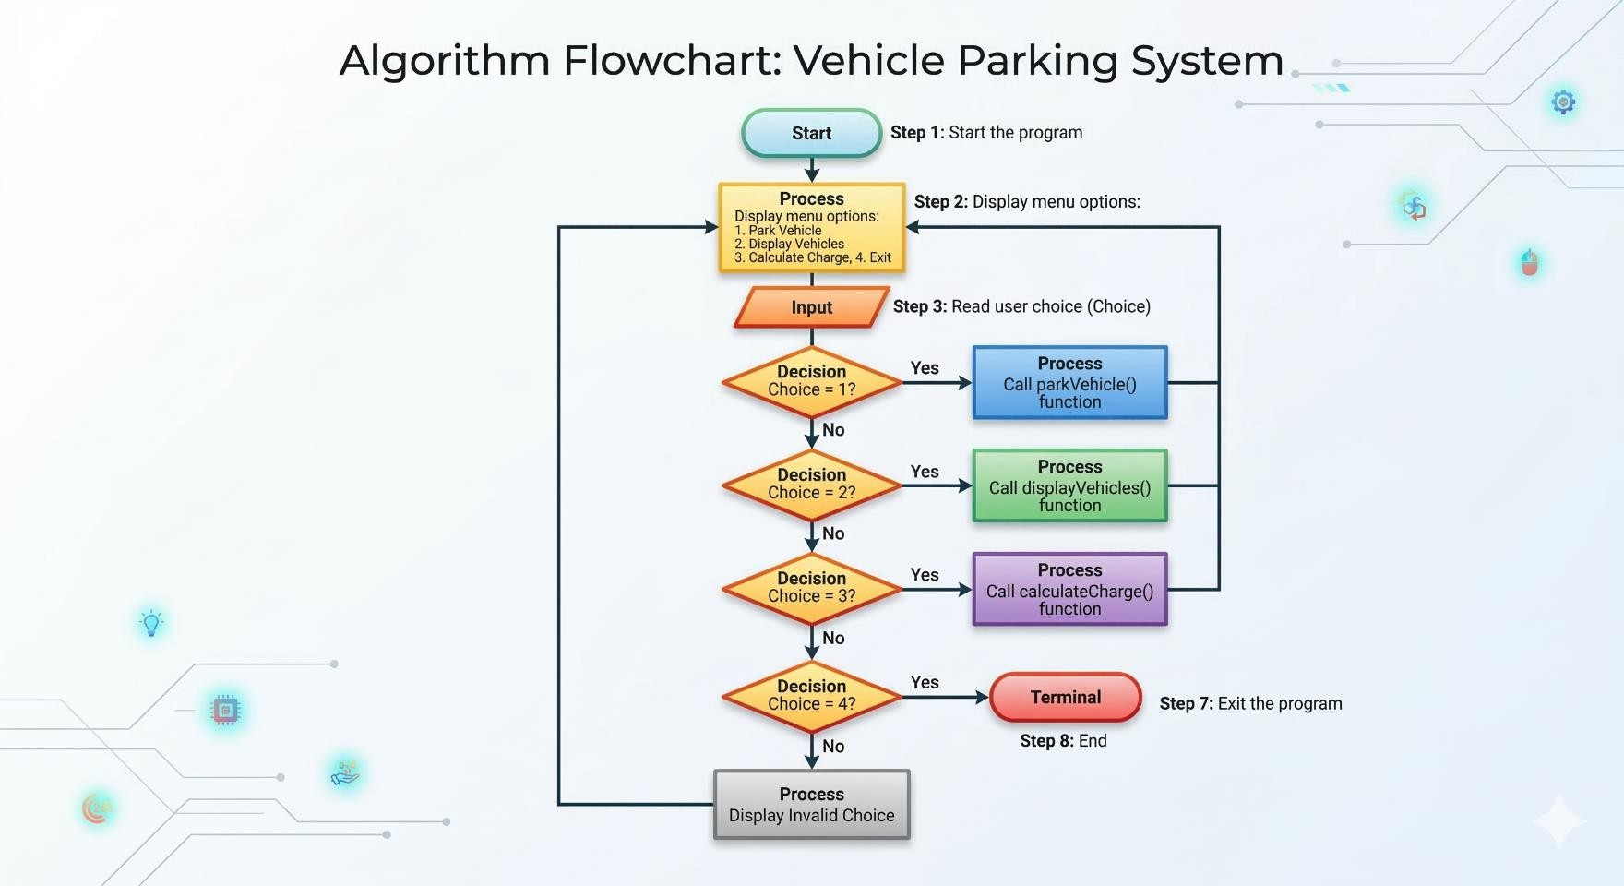

Slide 6
Software Requirements
Programming Language
C Programming Language Compiler
GCC
Turbo C
Dev C++ Operating System
Windows
Linux

Slide 7
System Design
The system is designed using a menu-driven approach.
Users can select different options from the menu to perform various operations.
Main components of the system include:
Vehicle Data Storage
Vehicle Entry Module
Vehicle Display Module
Charge Calculation Module

Slide 8
Data Structure Used
The project uses a structure to store vehicle details. struct Vehicle
{
int number; char type[10];
int hours;
};
Structure Fields
Vehicle Number – Unique identification number of the vehicle
Vehicle Type – Type of vehicle (Bike, Car, Truck)
Hours – Duration of parking

Slide 9
Module Division
Student 1 – Data Structure and File Handling
Create the Vehicle structure to store vehicle details.
Create and manage the parking data file.
Store vehicle records in the file using file handling.
Student 2 – Park Vehicle Module
Take vehicle details from the user.
Details include vehicle number, type, and parking hours.
Save the entered vehicle data into the file.
Student 3 – Display Vehicles Module
Read vehicle data from the file.
Show all parked vehicles on the screen.
Display vehicle number, type, and hours.
Student 4 – Parking Charge and Menu System

Slide 10
Calculate parking charges based on vehicle type and hours.
Connect all modules and run the program.
Algorithm
Step 1: Start the program
Step 2: Display menu options
Step 3: Read user choice
Step 4: If choice = 1
Call parkVehicle() function
Step 5: If choice = 2
Call displayVehicles() function
Step 6: If choice = 3
Call calculateCharge() function
Step 7: If choice = 4
Exit the program
Step 8: End

Slide 11
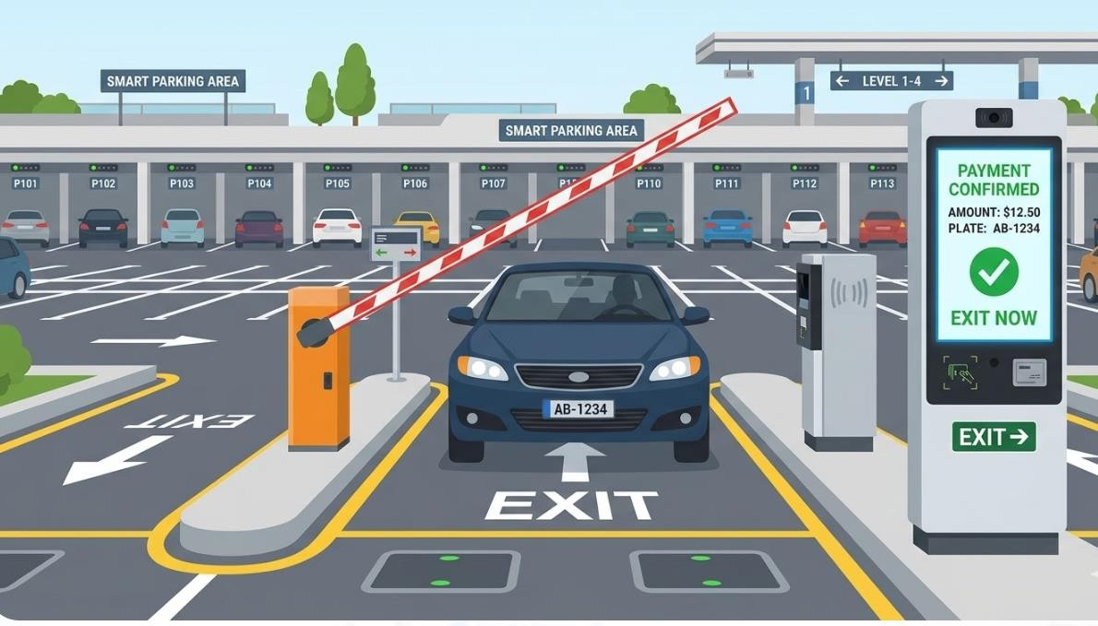

Slide 12
#include <stdio.h> #include <stdlib.h> #include <string.h>
struct Vehicle
{
int number; char type[10]; int hours;
};
void parkVehicle()
{
struct Vehicle v;

Slide 13
FILE *fp = fopen("parking.dat", "ab");
if (fp == NULL)
{
printf("File error\n"); return;
}
printf("Enter vehicle number: "); scanf("%d", &v.number);
printf("Enter vehicle type (Bike/Car/Truck): "); scanf("%s", v.type);

Slide 14
printf("Enter parking hours: "); scanf("%d", &v.hours);
fwrite(&v, sizeof(v), 1, fp); fclose(fp);
printf("Vehicle parked successfully.\n");
}
#include <stdlib.h> #include <string.h>

Slide 15
struct Vehicle
{
int number; char type[10];
int hours;
};
void parkVehicle()
{
struct Vehicle v;
FILE *fp = fopen("parking.dat", "ab");
if (fp == NULL)

Slide 16
{
printf("File error\n"); return;
}
printf("Enter vehicle number: "); scanf("%d", &v.number);
printf("Enter vehicle type (Bike/Car/Truck): "); scanf("%s", v.type);
printf("Enter parking hours: "); scanf("%d", &v.hours);

Slide 17
fwrite(&v, sizeof(v), 1, fp); fclose(fp);
printf("Vehicle parked successfully.\n");
}

Slide 18
Sample Output
Program Menu
--- VEHICLE PARKING SYSTEM ---
Park Vehicle
Display Parked Vehicles
Calculate Parking Charge
Exit
Example
Enter vehicle number: 1234 Enter vehicle type: Car Enter parking hours: 5
Vehicle parked successfully. Charge Calculation

Slide 19
Enter vehicle number: 1234 Total parking charge = Rs.100
Advantages
Easy to use
Simple implementation
Fast execution
File based data storage
Easy to extend
Future Enhancements
Add graphical user interface
Add parking slot management
Add entry and exit time tracking
Add automatic billing system

Slide 20
Conclusion
The Vehicle Parking Management System is a simple application developed using C programming.
The system demonstrates the use of structures, file handling, and menu-driven programming.
It efficiently stores vehicle records and calculates parking charges automatically.
The project provides a practical understanding of real-world problem solving using programming.

Slide 21
Thank You
Submitted By:
S.Jayaram Siva Prasad (25A31A05GB) D.Rohit (25A31A05FZ)
S.Sairam (25A31A05GA)
Nikhil (25A31A05FY)

